Slide 1
CyberSecurity chat Bot
Ntsakiso Chobede

Slide 2
Project Overview
Developed a CyberSecurity Awareness Chatbot in C# using windows forms
The main purpose of the chatbot educate users about online safety and cybersecurity topics
The chatbot includes GUI interaction,voice greeting,memory recall, and sentiment detection

Slide 3
Technologies used
C# Programmingg Language
Windows Forms (WinForms)
Objec-Oriented Programing (OOP)
GitHub for version control
GitHib actions for continuous intergration

Slide 4
Code structure
Program.cs – Starts the application.
Form1.cs – Handles GUI interactions.
ResponseManager.cs – Manages chatbot responses.
MemoryManager.cs – Stores user information.
SentimentAnalyzer.cs – Detects user emotions.
ConversationManager.cs – Maintains conversation flow.

Slide 5
Features implemented
Keyword recognition
Conversation flow
Memory recall
Sentiment detection
Voice greeting
Error handling

Slide 6
Voice greeting
Used System.Media.SoundPlayer.
A WAV audio file plays automatically when the chatbot starts.
Improves user interaction and presentation.

Slide 7
Github and ci
Created meaningful GitHub commits.
Used GitHub Actions for Continuous Integration.
Project automatically checks for build issues.

Slide 8
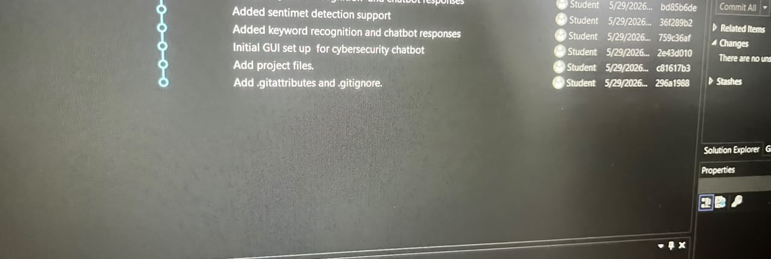

Github repository screenshot

Slide 9
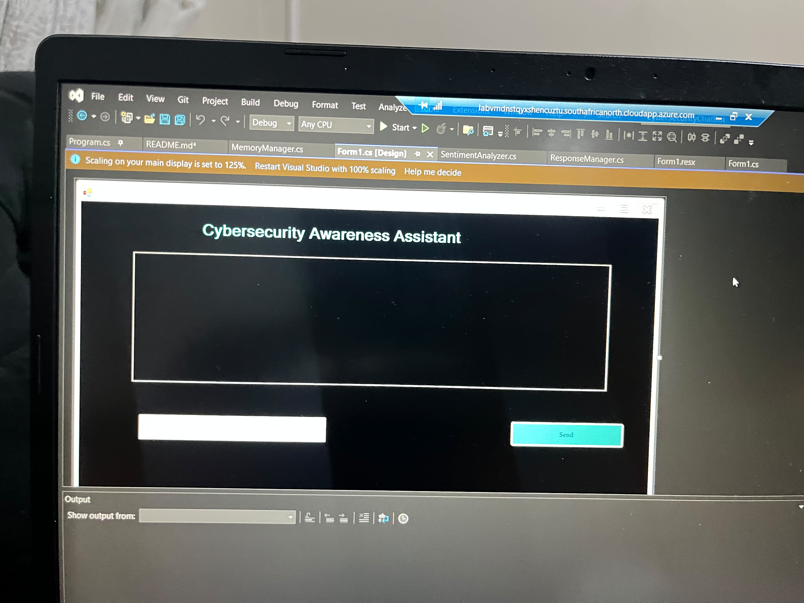

Gui

Slide 10
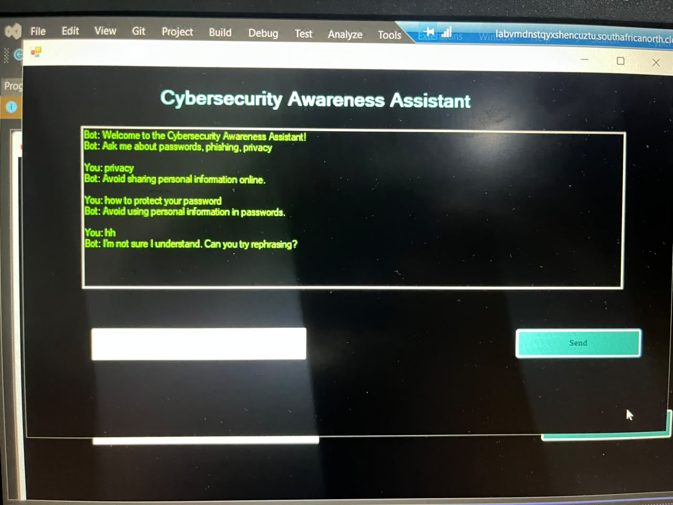

Chat conversation

